Slide 1
CSCE 3600 Principles of Systems Programming Compilers and Compilation
University of North Texas

Slide 2

Compiler Execution

Slide 3

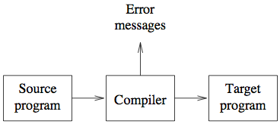
Compilation
A process that translates a program in one language (the source language) into an equivalent program in another language (the object or target language)
Important part is detection and reporting of errors
Source language usually high-level programming language (i.e., problem-oriented language)
Target language is a machine language or assembly language (i.e., machine-oriented language)
Compilation is the link between abstract world of application development and low-level world of application execution on machines

Slide 4

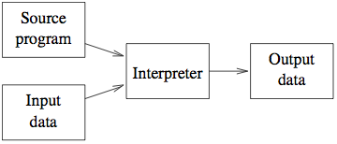
Types of Translators
Assembler is also a type of translator
Interpreter closely related to compiler, but takes both source program and input data
Translation and execution phases of the source program are the same
Easier implementation of programs (run-time errors immediately displayed)
Slower execution
Often requires more space
Notes:
Assembly language is machine-specific, but human-readable.
Assembly language contains:
-Descriptions of machine instructions
-Descriptions of data
-Address labels marking variables and functions (symbols)
-Metadata about the code and compiler transformations
All of the semantics of the C program are in the assembly. The structure of the assembly may be very different!

Slide 5
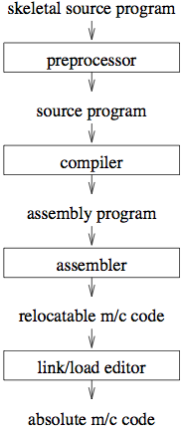
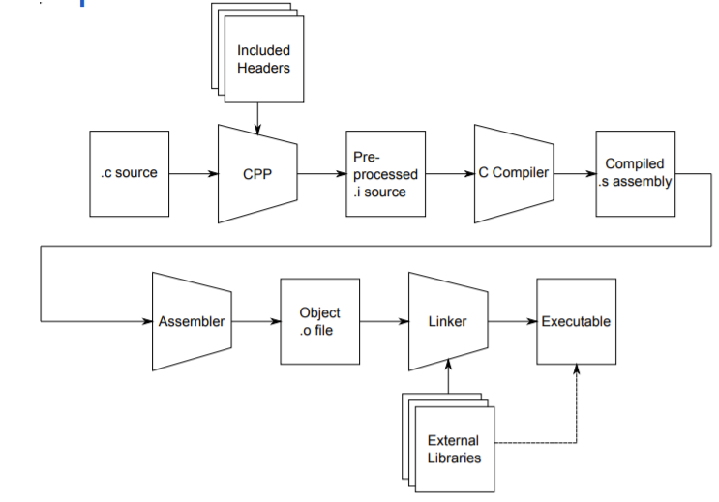
Program Compilation Process
Notes:
A C program consists of one or more source files.
The C compiler driver passes the source code through several stages to translate it into machine code.
A source file is sometimes called a translation unit.
The compiler is the only part of the toolchain that understands C. It understands:
The semantics of C, The capabilities of the machine
It uses these things to transform C into assembly

Slide 6
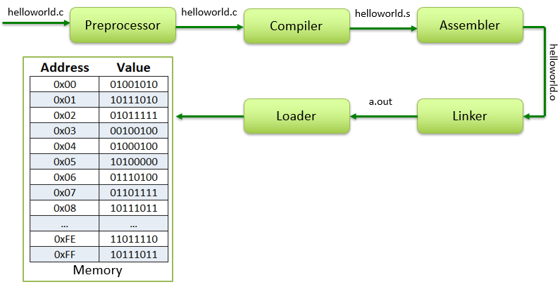
Program Compilation Process

Slide 7
C Preprocessor
Preprocessing
Occurs before a program is compiled
Inclusion of other files
Definition of symbolic constants and macros
Conditional compilation of program code
Conditional execution of preprocessor directives
Format of preprocessor directives
Lines begin with # (E.g. …… ? )
Only whitespace characters before directives on a line
Example
gcc –E helloworld.c
Stop after preprocessing and send output to stdout
Notes:
Preprocessor performs source code transformations before the C is processed by the compiler. It doesn’t understand C and can be used for other things!
#include, #define, #ifndef
The ‘#’ symbol indicates that, whatever statement starts with #, is going to the preprocessor program, and preprocessor program will execute this statement.
Remember that # symbol only provides a path that it will go to the preprocessor, and command such as include is processed by preprocessor program. For example, include will include extra code to your program.

Slide 8
#include Preprocessor Directive
Copy of a specified file included in place of directive
#include <filename>
Searches standard library for file
Use for standard library files
#include "filename"
Searches current directory, then standard library
Use for user-defined files
Used for
Programs with multiple source files compiled together
Header file has common declarations and definitions (classes, structures, function prototypes)
#include statement in each file
Notes:
The C preprocessor applies preprocessor directives and macros to a source file and removes comments.
Preprocessor directives end with the current line (not a semicolon)
The #include directive is primarily used to incorporate headers
There are two syntaxes for inclusion: #include <file> → Include a file from the system include path (defined by the toolchain)
#include "file" → Includes a file from the current directory

Slide 9
#define Preprocessor Directive
Symbolic constants
When program compiled, all occurrences of symbolic constant replaced with replacement text
Format
#define identifier replacement-text
Example:
#define PI 3.14159
Everything to right of identifier replaces text
#define PI = 3.14159
Replaces "PI" with "= 3.14159"
Cannot redefine symbolic constants once created
Notes:
The #define directive defines a symbol or macro:
# define PI 3.14159

Slide 10
#define Preprocessor Directive
Macro
Macro without arguments treated like a symbolic constant
A macro with arguments has its arguments substituted for replacement text, when the macro is expanded
Performs a text substitution – no data type checking
The macro
#define CIRCLE_AREA( r ) ( PI * ( r ) * ( r ) )
would cause
area = CIRCLE_AREA( 4 );
to become
area = ( 3.14159 * ( 4 ) * ( 4 ) );
Notes:
# define PLUSONE ( x ) ( x + 1)
PLUSONE ( PI ) /* Becomes (3.14159 + 1) */
Macros are expanded, not calculated! The expansion will be given directly to the compiler

Slide 11
#define Preprocessor Directive
Use parentheses
Without them the macro
#define CIRCLE_AREA( x ) PI * ( x ) * ( x )
would cause
area = CIRCLE_AREA( c + 2 );
to become
area = 3.14159 * c + 2 * c + 2;
Multiple arguments
#define RECTANGLE_AREA( x, y ) ( ( x ) * ( y ) )
would cause
rectArea = RECTANGLE_AREA( a + 4, b + 7 );
to become
rectArea = ( ( a + 4 ) * ( b + 7 ) );

Slide 12
#undef Preprocessor Directive
Undefines a symbolic constant or macro
If a symbolic constant or macro has been undefined, it can later be redefined
Example
#define WIDTH 80
#define ADD( X, Y ) ((X) + (Y))
.
.
.
#undef WIDTH
#undef ADD

Slide 13
Conditional Compilation
Control preprocessor directives and compilation
Cast expressions, sizeof, enumeration constants cannot be evaluated in preprocessor directives
Structure similar to if
#if !defined( NULL )
#define NULL 0
#endif
Determines if symbolic constant NULL has been defined
If NULL is defined, defined( NULL ) evaluates to 1
If NULL is not defined, this function defines NULL to be 0
Every #if must end with #endif
#ifdef short for #if defined( name )
#ifndef short for #if !defined( name )
Notes:
Conditional compilation as the name implies that the code is compiled if certain condition(s) hold true. Normally we use if keyword for checking some condition so we must use something different so that compiler can determine whether to compile the code or not. The different thing is #if.
In computer programming, conditional compilation is compilation implementing methods which allow the compiler to produce differences in the executable program produced and controlled by parameters that are provided during compilation.

Slide 14
Conditional Compilation
Other statements
#elif – equivalent of else if in an if structure
#else – equivalent of else in an if structure
"Comment out" code
Cannot use /* ... */
Use
#if 0
code commented out
#endif
To enable code, change 0 to 1

Slide 15
Compiler
GNU Compiler Collection (gcc) is standard Linux C compiler (see man gcc for details)
Compiler translates C program to assembler code
Example
gcc –S helloworld.c
Stop after stage of compiling proper (i.e., not passed to assembler) and outputs assembler code to helloworld.s
Compiler actually consists of many parts (more later)
Parser
Analyzer
Code optimizer
Code generation

Slide 16
Assembler
Assembles, but does not link, source code to generate relocateable object code
Object code may contain metadata such as label definitions that refer to locations within sections of code
May include holes (i.e., relocation entries) that are to be filled with the values of labels defined elsewhere
Example
gcc –c helloworld.c
Assemble source code and save object file as helloworld.o
Use nm or objdump to look at object
nm example.o
objdump –t example.o

Slide 17
Linker
Combines previous compiled and assembled object code along with standard library functions to make executable file
Resolves references in each object file to external variables and procedures declared in other files
Example
gcc helloworld.o
Build default executable a.out
Use gcc –lm helloworld.o to link math library
Use nm to look at executable

Slide 18
Loader
Compilers, assemblers, and linkers usually produce code whose memory references are made relative to an undetermined starting location that can be anywhere in memory (relocatable machine code)
The loader ensures that the object programs are placed in memory in an executable form
Loader calculates appropriate absolute addresses for these memory locations and amends the code to use these addresses
Gets an address from the OS to place the program in memory
Changes necessary addresses (if any)
Places code into memory to run

Slide 19
Compiling and Linking
Only compiling (creating hello.o)
gcc –c hello.c
Only linking
gcc hello.o –o hello
Compiling and linking
gcc hello.c –o hello
To run your program
./hello
Hello World!
Additional common flags to gcc
–g allows debugging
–l<library_name> linking with external libraries
If you leave off the –o, executable goes into the a.out file

Slide 20
Compiler Construction

Slide 21



What is a Compiler?
All computers only understand machine language
Therefore, high-level language instructions must be translated into machine language prior to execution
This is
a program
10000010010110100100101……

Slide 22
What is a Compiler?
Consists of a piece of system software that translates high-level languages into machine language
program.c
while (c !='x')
{
if (c == 'a' || c == 'e' || c == 'i')
printf("Congrats!");
else
if (c!='x')
printf("Sorry!");
}
Congrats!
prog
Compiler
10000010010110100100101……
gcc -o prog program.c

Slide 23
Why Build Compilers?
Compilers provide an essential interface between applications and architectures
High level programming languages:
Increase programmer productivity
Better maintenance
Portable
Low level machine details:
Instruction selection (a stage at the compiler backend)
Addressing modes
Pipelines
Registers and cache
Compilers efficiently bridge the gap and shield the application developers from low level machine details
Notes:
Addressing modes: how the machine language instructions in that architecture identify the operand(s) of each instruction. An addressing mode specifies how to calculate the effective memory address of an operand by using information held in registers and/or constants contained within a machine instruction or elsewhere.
Pipelines operate at the lowest abstraction level. This is where actual data gets moved and transformed, and we end up with very rigid concretions
For example, for the following sequence of middle-level IR code
t1 = a t2 = b t3 = t1 + t2 a = t3 b = t1 a good instruction sequence for the x86 architecture is
MOV EAX, a XCHG EAX, b ADD a, EAX

Slide 24
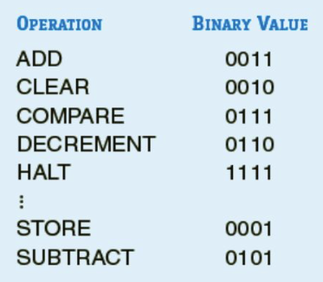

Assembler
A kind of compiler
One-to-one translation
LOAD X Assembly
(opcode table)
(symbol table)
0100 0000 0000 1001 Machine Language

Slide 25
Compiler
A high-level language translator
One-to-many translation
a = b + c - d;
0100 00001110001 LOAD B
0011 00001110010 ADD C
0101 00001110011 SUBTRACT D
0001 00001110100 STORE A
0100 00001110001 0011 00001110010…….

Slide 26
Compiler Properties
Compiler must generate a correct executable
The input program and the output program must be equivalent, the compiler should preserve the meaning of the input program
Output program should run fast
For optimizing compilers, we expect the output program to be more efficient than the input program
Compiler itself should be fast
Compiler should provide good diagnostics for programming errors
Compiler should support separate compilation (Notes)
Compiler should work well with debuggers
Optimizations should be consistent and predictable
Compile time should be proportional to code size
Notes:
Separate compilation: C++ supports separate compilation, where pieces of the program can be compiled independently through the two stage approach of compilation and then linking, so changes to one class would not necessarily require the re-compilation of the other classes. The compiled pieces of code ( .o or .obj files)^{[8]} are combined through the use of the linker (in the use of Borland C++ it is ilink32.exe). Separate compilation allows programs to be compiled and tested one class at a time, even built into libraries for later use. It is therefore good practice to place each class in a separate source file to take full advantage of separate compilation with the C++ language.

Slide 27
Compiler Goals
Code produced must be correct
A = (B + C) – (D + E);
Possible translation:
LOAD B
ADD C
STORE B
LOAD D
ADD E
STORE D
LOAD B
SUBTRACT D
STORE A
Is this correct?
No - STORE B and STORE D change the values of variables B and D which the high-level language does not intend

Slide 28
Compiler Goals
Code produced should be reasonably efficient and concise
Compute the sum: 2x₁+ 2x₂+ 2x₃+ 2x₄+….+ 2x₅₀₀₀₀
sum = 0.0
for (i = 0; i < 50000; i++)
sum = sum + (2.0 * x[i]);
Optimizing compiler:
sum = 0.0
for (i = 0; i < 50000; i++)
sum = sum + x[i];
sum = sum * 2.0; 49,999 less instructions

Slide 29
Why Study Compilers?
Compilers embody a wide range of theoretical techniques and their application to practice
DFAs, DPDAs, formal languages, formal grammars, lattice theory
Compiler construction teaches programming and software engineering skills
Compiler construction involves a variety of areas
Theory, algorithms, systems, architecture
The techniques used in various parts of compiler construction are useful in a wide variety of applications
Many practical applications have embedded languages, commands, macros, etc.
Is compiler construction a solved problem?
No! New developments in programming languages and machine architectures (multicore machines) present new challenges

Slide 30
Syntax & Semantics of Language
A programming language must include the specification of syntax (structure) and semantics (meaning)
Syntax typically means the context-free syntax because of the almost universal use of context-free grammars (CFGs)
Example
a = b + c is syntactically legal
b + c = a is illegal
The semantics of a programming language are commonly divided into two classes
Static semantics
Semantics rules that can be checked at compile time
E.g., the type and number of a function’s argument(s)
Runtime semantics
Semantics rules that can be checked only at run time
CFG is a set of recursive rewriting rules used to generate patterns of strings

Slide 31
Compilation
Translate high-level program (source language) into machine code (machine language)
Slow translation, fast execution
Compilation process has several phases:
Lexical Analysis (or Tokenization)
Converts characters in source program into lexical units
Syntax Analysis
Transforms lexical units into parse trees that represent the syntactic structure of program
Semantics Analysis
Generate intermediate code
Code Generation
Machine code is generated
Notes:
Lexical Analysis: process of converting a sequence of characters (such as in a computer program or web page) into a sequence of tokens (strings with an assigned and thus identified meaning)

Slide 32
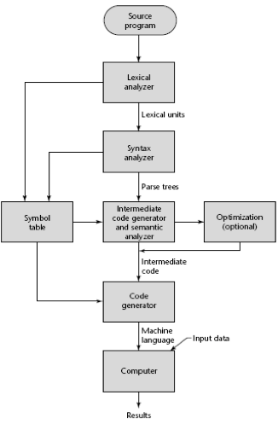
Compilation Stages
For many compilers, the result is assembly, which then has to be run through an assembler
Lexical analysis (scanner)
Syntax analysis (parser)
Semantic analysis
Intermediate code generation
Machine-independent code improvement (optional)
Target code generation
Machine-specific code improvement (optional)
machine independent

Slide 33
Lexical Analysis
Lexical analyzer or scanner
Recognizes the “tokens” of a program
The compiler scans the source code from left-to-right, character-by-character, and groups these characters into lexemes (sequence of characters that match a pattern) and outputs a sequence of tokens to the syntax analyzer
Each token represents a logically cohesive sequence of characters
Keywords
if, while, ...
Operators
+, *, <=, ||, ...
Identifiers (names of variables, arrays, procedures, classes)
i, i1, j1, count, sum, ...
Numbers
12, 3.14, 7.2E-2, …
Scanner
Source
code
Groups
of
tokens

Slide 34
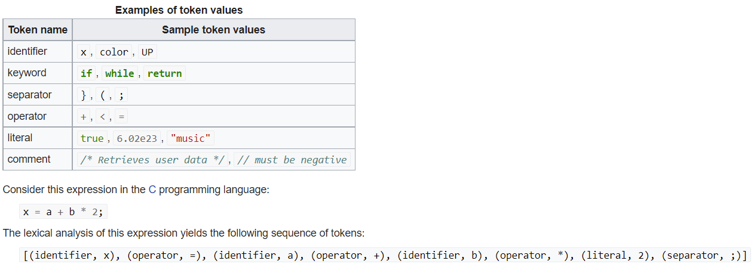
Lexical Analysis
Indivisible entities for the purpose of translation

Slide 35
Lexical Analysis
The main functions of this phase are
Identify the lexical units in a source statement
Classify units into different lexical classes (e.g., constants, reserved words, etc.) and enter them in different tables
Build a descriptor (called a token) for each lexical unit (group of input characters)
Ignore comments in the source program
Detect tokens that are not a part of the language
Tokens are syntactical units that are treated as single, indivisible entities for the purposes of translation

Slide 36
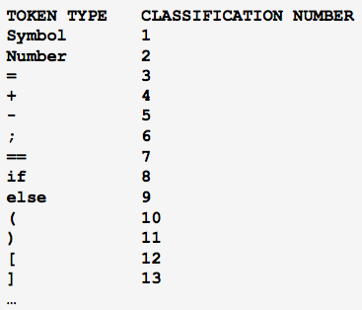
Lexical Analysis Example
Program statement
sum = sum + a[i];
Digital perspective:
tab,s,u,m,blank,=,blank,s,u,m,blank,+,blank,a,[,i,],;
Tokenized:
sum,=,sum,+,a[i],;
Typical
Token
Classifications

Slide 37
Lexical Analysis Process
Discard blanks, tabs, etc. – look for beginning of token
Put characters together
Repeat step 2 until end of token
Classify and save token
Repeat steps 1 – 4 until end of statement
Repeat steps 1 – 5 until end of source code
sum 1
= 3
+ 4
a 1
[ 12
i 1
] 13
; 6
sum=sum+a[i];
Scanner

Slide 38
How Do We Specify Lexical Patterns?
Some patterns are easy
Keywords and operators
Specified as literal patterns: if, then, else, while, =, +, …
Some patterns are more complex
Identifiers
Letter followed by letters and digits
Numbers
Integer: 0 or a digit between 1 and 9 followed by digits between 0 and 9
Decimal: An optional sign which can be “+” or “-” followed by digit “0” or a nonzero digit followed by an arbitrary number of digits followed by a decimal point followed by an arbitrary number of digits
We want to have concise descriptions of patterns, and we want to automatically construct the scanner from these descriptions

Slide 39
Language Definitions
An alphabet Σ is a finite non-empty set (of symbols)
A string or word over an alphabet Σ is a finite concatenation of symbols from Σ
The length of a string w (i.e., number of characters comprising the string) is denoted |w|
The empty or null string is denoted ε (i.e., |ε|=0)
The set of all strings over Σ is denoted Σ*
For each n ≥ 0, we define Σ^{n} = {w∈Σ* | |w| = n}
For a symbol or word x, x^{n} denotes x concatenated with itself n times, with the convention that x⁰ denotes ε
A language over Σ is a set L ⊆ Σ*
Two languages L₁ and L₂ over common alphabet Σ are equal if they are equal as sets

Slide 40
Lexical Analyzer: Regular Expression
The lexical analyzer needs to scan and identify only a finite set of valid string/token/lexeme that belong to the language in hand. It searches for the pattern defined by the language rules.
RegExes have the capability to express finite languages by defining a pattern for finite strings of symbols. The grammar defined by regular expressions is known as regular grammar. The language defined by regular grammar is known as regular language.
Regular expression is an important notation for specifying patterns. Each pattern matches a set of strings, so regular expressions serve as names for a set of strings.
Programming language tokens can be described by regular languages.
The specification of regular expressions is an example of a recursive definition. Regular languages are easy to understand and have efficient implementation.
There are a number of algebraic laws that are obeyed by regular expressions, which can be used to manipulate regular expressions into equivalent forms

Slide 41
RegEx: Operations
The various operations on languages are:
Union of two languages L and M is written as
L U M = {s | s is in L or s is in M}
Concatenation of two languages L and M is written as
LM = {st | s is in L and t is in M}
The Kleene Closure of a language L is written as
L* = Zero or more occurrence of language L.

Slide 42
RegEx: Notations
If r and s are regular expressions denoting the languages L(r) and L(s), then
Union : (r)|(s) is a regular expression denoting L(r) U L(s)
Concatenation : (r)(s) is a regular expression denoting L(r)L(s)
Kleene closure : (r)* is a regular expression denoting (L(r))*
(r) is a regular expression denoting L(r)

Slide 43
RegEx: Precedence & Associativity
*, concatenation (.), and | (pipe sign) are left associative
* has the highest precedence
Concatenation (.) has the second highest precedence.
| (pipe sign) has the lowest precedence of all.

Slide 44
RegEx: Representing valid tokens of a language in Regex
If x is a regular expression, then:
x* means zero or more occurrence of x. i.e., it can generate { e, x, xx, xxx, xxxx, … }
x+ means one or more occurrence of x. i.e., it can generate { x, xx, xxx, xxxx … } or x.x*
x? means at most one occurrence of x i.e., it can generate either {x} or {e}.
[a-z] is all lower-case alphabets of English language.
[A-Z] is all upper-case alphabets of English language.
[0-9] is all natural digits used in mathematics.

Slide 45
RegEx: Representing symbols, language tokens using regex
Representing occurrence of symbols using regular expressions
letter = [a – z] or [A – Z]
digit = 0 | 1 | 2 | 3 | 4 | 5 | 6 | 7 | 8 | 9 or [0-9]
sign = [ + | - ]
Representing language tokens using regular expressions
Decimal = (sign)?(digit)+
Identifier = (letter)(letter | digit)*
The only problem left with the lexical analyzer is how to verify the validity of a regular expression used in specifying the patterns of keywords of a language. A well-accepted solution is to use finite automata for verification.

Slide 46
RegEx Examples
All strings of 1s and 0s
( 0 | 1 )*
All strings of 1s and 0s beginning with a 1
1 ( 0 | 1 )*
All strings of 0s and 1s containing at least two consecutive 1s
( 0 | 1 )* 1 1( 0 | 1 )*
All strings of alternating 0s and 1s
( ε | 1 ) ( 0 1 )* ( ε | 0 )

Slide 47
Regular Expression Examples
Digit → (0|1|2| … |9)
Integer → (+|-)? (0| (1|2|3| … |9)(Digit *))
Decimal → Integer "." Digit *
Real → ( Integer | Decimal ) E (+|-)?Digit *
Complex → " (" Real , Real " ) "
Numbers can get even more complicated.

Slide 48
RegEx Extensions (Lex)
x+= x x* denotes L(x)⁺
x? = x | ε denotes L(x) ∪ {ε}
[abc] = a | b | c matches one character in the square bracket
a-z = a | b | c | ... | z range
[0-9a-z] = 0 | 1 | 2 | ... | 9 | a | b | c | ... | z
[^abc] ^ means negation
matches any character except a, b or c
. (dot) matches any character except the newline
. = [^\n] \n means newline, dot is equivalent to [^\n]
“[” matches left square bracket, metacharacters in double quotes become plain characters
\[ matches left square bracket, metacharacter after backslash becomes plain character

Slide 49
Regular Definitions
We can define macros using regular expressions and use them in other regular expressions
Letter → (a|b|c| … |z|A|B|C| … |Z)
Digit → (0|1|2| … |9)
Identifier → Letter ( Letter | Digit )*
Important: We should be able to order these definitions so that every definition uses only the definitions defined before it (i.e., no recursion)
Regular definitions can be converted to basic regular expressions with macro expansion
In Lex, enclose definitions using curly braces
Identifier → {Letter} ( {Letter} | {Digit} )*

Slide 50

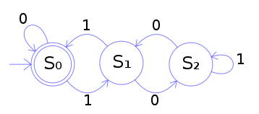
Regular Expression to Scanners
Regular expressions are useful for specifying patterns that correspond to tokens
However, we also want to construct programs that recognize these patterns (are these programs called recognizers?)
How do we do it?
Use finite automata!

Slide 51
RegEx to DFA Example
Consider the problem of recognizing register names in an assembler (e.g. R0, R1, R2….. )
Register → R (0|1|2| … |9) (0|1|2| … |9)*
Allows registers of arbitrary number
Requires at least one digit
REGEX corresponds to a recognizer (or DFA)
A recognizer tells whether a given string “belongs to” a grammar
(0|1|2| … |9)
R
(0|1|2| …|9)
S₀
S₁
S₂
R
accepting state
initial state
R
(0|1|2| …|9)
S_{e}
error state
Recognizer for Register
(R|0|1|2| …|9)

Slide 52
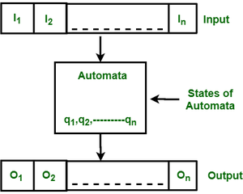
Finite Automata
Finite Automata(FA) is the simplest machine to recognize patterns.
The finite automata or finite state machine is an abstract machine that has five elements or tuples.
It has a set of states and rules for moving from one state to another but it depends upon the applied input symbol.
Basically, it is an abstract model of a digital computer.
The figure shows some essential features of general automation.
Input
Output
States of automata
State relation
Output relation

Slide 53
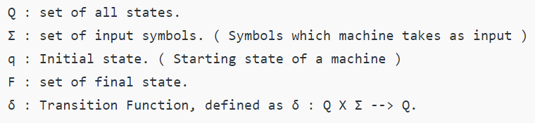
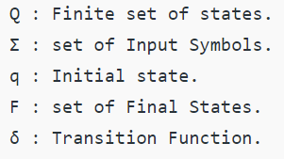

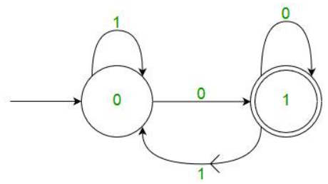
Finite Automata
A Finite Automata consists of the following :
Formal specification of machine is :
FA is characterized into : DFA NFA
DFA consists of 5 tuples:
In a DFA, for a particular input character, the machine goes to one state only.
A transition function is defined on every state for every input symbol.
Also in DFA null (or ε) move is not allowed, i.e., DFA cannot change state without any input character.
For example, below DFA with Σ = {0, 1} accepts all strings ending with 0.
Notes:
One important thing to note is, there can be many possible DFAs for a pattern. A DFA with a minimum number of states is generally preferred.

Slide 54
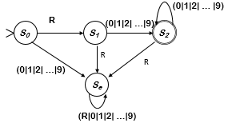
Deterministic Finite Automata (DFA)
A set of states S
S = { s₀ , s₁ , s₂ , s_{e}}
A set of input symbols (an alphabet) Σ
Σ = { R , 0 , 1 , 2 , 3 , 4 , 5 , 6 , 7 , 8 , 9 }
A transition function δ : S × Σ → S
Maps (state, symbol) pairs to states
δ = { ( s₀ , R) → s₁, ( s₀ , 0-9) → s_{e} ,( s₁ , 0-9 ) → s₂ ,( s₁ , R ) → s_{e} ,
( s₂ , 0-9 ) → s₂ , ( s₂ , R ) → s_{e} , ( s_{e} , R | 0-9 ) → s_{e} }
A start state
s₀
A set of final (or accepting) states
Final = { s₂ }
A DFA accepts a word x iff there exists a path in the transition graph from start state to a final state such that the edge labels along the path spell out x

Slide 55
DFA Simulation
Start in state s₀ and follow transitions on each input character
DFA accepts a word x iff x leaves it in a final state (s₂ ) alternately, In general, a DFA accepts ε if and only if the start state is also an accept state.
So,
“R17” takes it through s₀ , s₁ , s₂ and accepts
“R” takes it through s₀ , s₁ and fails
“A” takes it straight to s_{e}
“R17R” takes it through s₀ , s₁ , s₂ , s_{e} and rejects
(0|1|2| …|9)
S₀
R
S₁
(0|1|2| …|9)
S₂
accepting state
initial state
Recognizer for Register
Notes:
In general, a DFA accepts ε if and only if the start state is also an accept state.

Slide 56
DFA Simulation
We can store the transition table in a
two-dimensional array:
state = s₀ ;
char = get_next_char();
while (char != EOF) {
state = δ(state,char);
char =get_next_char();
}
if (state ∈ Final)
report acceptance;
else
report failure;
0
,1,
2
,3,
δ
R
4
,5,
6
,
ot
h
e
r
7
,8,
9
S
0
S
1
S
e
S
e
S
1
S
e
S
2
S
e
S
2
S
e
S
2
S
e
S
e
S
e
S
e
S
e
Final = { s₂ }
We can also store the final states in an array
The recognizer translates directly into code
To change DFAs, just change the arrays
Takes O(|x|) time for input string x

Slide 57
Recognize Longest Accepted Prefix
accepted = false;
current_string = ε; // empty string
state = s₀ ; // initial state
if (state ∈ Final) {
accepted_string = current_string;
accepted = true;
}
char =get_next_char();
while (char != EOF) {
state = δ(state,char);
current_string = current_string + char;
if (state ∈ Final) {
accepted_string = current_string;
accepted = true;
}
char =get_next_char();
}
if accepted
return accepted_string;
else
report error;
Given an input string, this simulation
algorithm returns the longest accepted
prefix
0
,1,
2
,3,
δ
R
4
,5,
6
,
ot
h
e
r
7
,8,
9
S
0
S
1
S
e
S
e
S
1
S
e
S
2
S
e
S
2
S
e
S
2
S
e
S
e
S
e
S
e
S
e
Final = { s₂ }
Given the input “R17R” , this simulation
algorithm returns “R17”

Slide 58
Syntax Analysis
Syntax analyzer, or parser, groups sequences of tokens from the lexical analysis phase into phrases, each with an associated phrase type (i.e., a logical unit with respect to the rules of the source language)
The following operations are performed in this phase
Obtain tokens from lexical analyzer
Check whether the expression is syntactically correct
Report syntax errors, if any
Determine the statement class
An assignment statement, a condition (e.g., if) statement, etc.
Group tokens into statements
Construct hierarchical structures called parse trees
Parse trees represent the syntactic structure of the program
Notes:
A parse tree is an entity which represents the structure of the derivation of a terminal string from some non-terminal (not necessarily the start symbol)

Slide 59
Grammars and Parse Trees
The grammar S → aSbS | bSaS | ε generates all strings of a’s and b’s with the same number of a’s as b’s
This grammar is ambiguous: abab has two parse trees
S
S
a
S
b
S
a
S
b
S
b
S
a
S
ε
ε
a
S
b
S
ε
ε
ε
ε
(ab)^{n} has parse trees

Slide 60
Grammars and Parse Trees
Natural languages are inherently ambiguous
But programming languages should not be!
This grammar G generates the same language
S → aAbS | bBaS | ε
A → aAbA | ε
B → bBaB | ε
G is unambiguous and has only one parse tree for every sentence in L(G)
S
a
A
b
S
ε
a
A
b
S
ε
ε

Slide 61
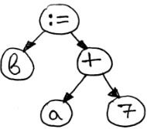
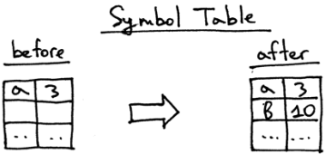
Parse Trees
The statement b = a + 7 can be represented by the following parse tree
Parse tree illustrates the grouping of tokens into phrases
Successful construction of a parse tree is proof that the statement is correctly formed

Slide 62
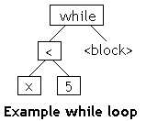
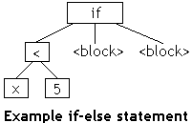
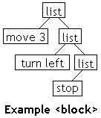
Parse Trees
Every construct (statement, expression, etc.) in a programming language can be represented as a parse tree
Terminals
The actual tokens of the language
Non-Terminals
Intermediate grammatical categories used to help explain and organize the language

Slide 63
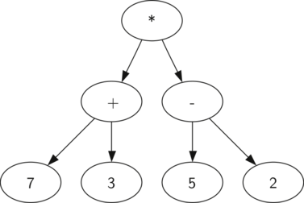
Example: Expression evaluation
Using the information from above we can define four rules as follows:
If the current token is a '(', add a new node as the left child of the current node, and descend to the left child.
If the current token is in the list ['+','-','/','*'], set the root value of the current node to the operator represented by the current token. Add a new node as the right child of the current node and descend to the right child.
If the current token is a number, set the root value of the current node to the number and return to the parent.
If the current token is a ')', go to the parent of the current node.
Non-Terminals
Terminals
Parse tree for ((7+3)*(5-2))

Slide 64
Recursive Descent Parser
Simplest idea for creating a parser for a grammar is to construct a recursive descent parser
Built from a context-free grammar
Simple rules used to build the recursive program
Implement a function for each non-terminal
Generate code for each rule
“Call” non-terminals
“Match” terminals
Use if statement to choose between multiple rules with the same (non-terminal) symbol

Slide 65
Recursive Descent Parser
Advantages
They are exceptionally simple
They can be constructed from recognizers simply by doing some extra work – specifically, building a parse tree
Disadvantages
They are not as fast as some other methods
It is difficult to provide really good error messages
They cannot do parses that require arbitrarily long look-aheads
Recursive descent parsers are great for “quick and dirty” parsing jobs

Slide 66
Recursive Descent Parser Stack
One easy way to do recursive descent parsing is to have each parse method take the tokens it needs, build a parse tree, and put the parse tree on a global stack
Write a parse method for each non-terminal in the grammar
Each parse method should get the tokens it needs, and only those tokens
Those tokens (usually) go on the stack
Each parse method may call other parse methods, and expect those methods to leave their results on the stack
Each (successful) parse method should leave one result on the stack

Slide 67
Example: while Statement
<while statement> ::= "while" <condition> <block>
The parse method for a while statement:
Calls the Tokenizer, which returns a "while" token
Makes "while" into a tree node, which it puts on the stack
Calls the parser for <condition>, which parses a condition and puts it on the stack
Stack contains: "while" <condition> ("top" is on right)
Calls the parser for <block>, which parses a block and puts it on the stack
Stack now contains: "while" <condition> <block>
Pops the top three things from the stack, assembles them into a tree, and pushes this tree onto the stack

Slide 68
Recognizing a while Statement
// <while statement> ::= "while" <condition> <block> int whileStatement()
{ if (keyword("while")) { if (condition()) { if (block()) { return 1; // true } else error("Missing '{' "); } else error("Missing <condition>"); } return 0; // false }

Slide 69
Parsing a while Statement
// <while statement> ::= "while" <condition> <block> int whileStatement() { if (keyword("while")) { if (condition()) { if (block()) { makeTree(3, 2, 1); return 1; // true } else error("Missing '{' "); } else error("Missing <condition>"); } return 0; // false }
This code assumes that keyword(String), condition(), and block() all leave their results on a stack
On the stack, while = 3, <condition> = 2, <block> = 1

Slide 70
Parsing a while Statement
After recognizing a while loop, the stack looks
like this:
void makeTree(int keyword, int left, int right) { Tree root = getStackItem(keyword); Tree leftChild = getStackItem(left); Tree rightChild = getStackItem(right); stack.pop(); stack.pop(); stack.pop(); root.addChild(leftChild); root.addChild(rightChild); stack.push(root); }
<block>
<condition>
while
LIFO stack
while
keyword
<condition>
<block>
left
right

Slide 71
Compiler Component Generators
flex
specification
yacc
specification
Lexical
Analyzer
Generator
(flex)
Syntax
Analyzer
Generator
(yacc)
Lexical
Analyzer
Syntax
Analyzer
source
program
token
stream
syntax
tree
Notes:
flex is a tool for generating scanners: programs which recognized lexical patterns in text. flex reads the given input files, or its standard input if no file names are given, for a description of a scanner to generate.
The description is in the form of pairs of regular expressions and C code, called rules. flex generates as output a C source file, `lex.yy.c', which defines a routine `yylex()'. This file is compiled and linked with the `-lfl' library to produce an executable. When the executable is run, it analyzes its input for occurrences of the regular expressions. Whenever it finds one, it executes the corresponding C code.

Slide 72
flex and yacc – Compiler tools
flex is a tool for generating scanners: programs which recognized lexical patterns in text. flex reads the given input files, or its standard input if no file names are given, for a description of a scanner to generate.
The description is in the form of pairs of regular expressions and C code, called rules.
flex generates as output a C source file, `lex.yy.c', which defines a routine `yylex()'. This file is compiled and linked with the `-lfl' library to produce an executable. When the executable is run, it analyzes its input for occurrences of the regular expressions. Whenever it finds one, it executes the corresponding C code.
Computer program input generally has some structure; in fact, every computer program that does input can be thought of as defining an ``input language'' which it accepts. An input language may be as complex as a programming language, or as simple as a sequence of numbers. Unfortunately, usual input facilities are limited, difficult to use, and often are lax about checking their inputs for validity.
Yacc provides a general tool for describing the input to a computer program. The Yacc user specifies the structures of this input, together with code to be invoked as each such structure is recognized.
Yacc turns such a specification into a subroutine that handles the input process; frequently, it is convenient and appropriate to have most of the flow of control in the user's application handled by this subroutine.
Notes:
http://dinosaur.compilertools.net/

Slide 73
Desk Calculator Example
flex specification for a desk calculator: desk.l
$ flex desk.l
yacc specification for a desk calculator: desk.y
$ yacc desk.y
This generates a file called y.tab.c, but before compiling this resulting file, you must add the following function prototypes near the top of the file:
int yylex(void);
void yyerror(const char *);
Now compile this file with the flex and yacc libraries
$ gcc y.tab.c -ly -lfl
in public
directory

Slide 74
Desk Calculator Example (cont’d)
$ ./a.out
Enter the expression: 1.8+2.8
Answer: 4.6
Enter:
1.8*10
Answer: 18
Enter:
20.34/.2
Answer: 101.7
Enter:
101.7*.2
Answer: 20.34
Enter:
1.2*(3.4+5.6)
Answer: 10.8
Enter:
^C

Slide 75
Intermediate Code Generation
The intermediate code produces a program in a different language, at an intermediate level between the source code and the machine code
This allows part of the compiler to be machine independent!
Intermediate languages are sometimes assembly languages
Generation of intermediate code offers following advantages
Flexibility
A single lexical analyzer/parser can be used to generate code for several different machines by providing separate back-ends that translate a common intermediate language to a machine-specific assembly language
Intermediate code is used in interpretation
Executed directly rather than translating it into binary code and storing it

Slide 76
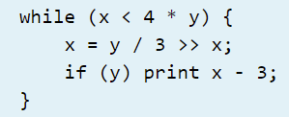
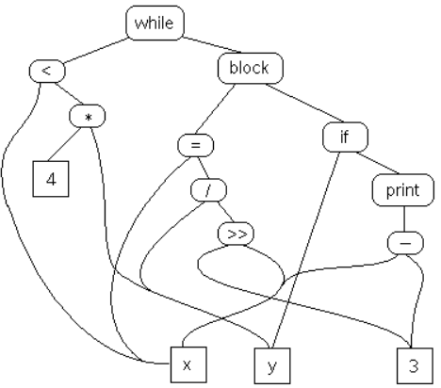
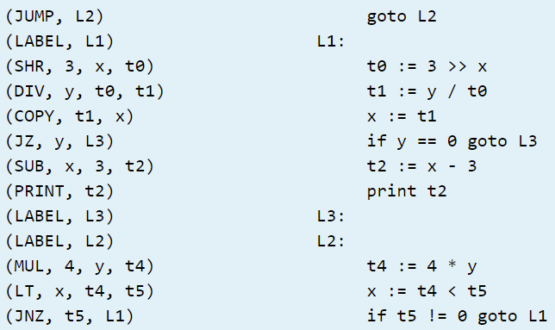
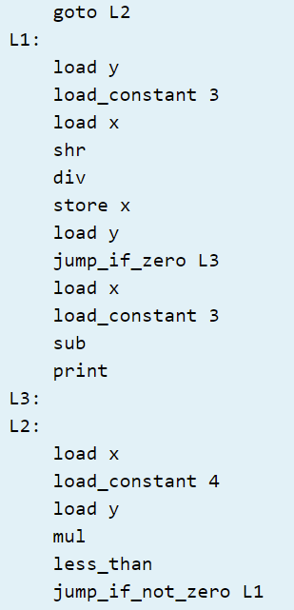
Intermediate Code Generation
Example code:
Intermediate representations (IR) are usually:
Structured (graph or tree-based)
Flat, tuple-based, generally three-address code (quadruples)
Flat, stack-based
Or any combination of the above three
Semantic graph
Tuples
Stack code
https://cs.lmu.edu/~ray/notes/ir/

Slide 77

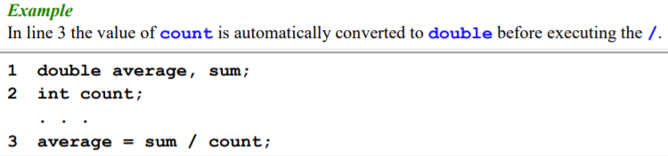
Semantic Analysis
A semantic analyzer takes its input from the syntax analysis phase in the form of a parse tree and a symbol table
Its purpose is to determine if the input has a well-defined meaning
In practice, semantic analyzers are mainly concerned with type checking and type coercion based on type rules
Type coercion is the automatic conversion of a datum from one data type to another within an expression. Coercion occurs because the datum is stored as one data type but its context requires a different data type.
Notes:
http://faculty.salina.k-state.edu/tmertz/Java/041datatypesandoperators/07typecoercionandconversion.pdf

Slide 78
Semantic Analysis
The semantic phase has the following functions:
Check phrases for semantic errors (e.g., type checking)
In a C program, int x = 10.5; should be detected as a semantic error
Keeps track of types of identifiers and expressions to verify their consistent usage
Maintains the symbol table
Symbol table contains information about each identifier in a program, such as identifier type, scope of identifier, etc.

Slide 79
Semantic Analysis
The semantic phase has the following functions:
Enforces a large number of rules using the symbol table
Every identifier is declared before it is used
No identifier is used in an inappropriate context (e.g., adding a string to an integer)
Function calls have a correct number and type of arguments
Checks certain semantic rules, called dynamic semantics, at run time
E.g.:Array subscript expression lies within the bounds of the array
E.g.:Variables are never used in an expression unless they have been given a value

Slide 80
Symbol Table
Built and maintained by the semantic analyzer
Maps each identifier to information known about it
Identifier’s type (e.g., int, char, float, etc.)
Internal structure (if any)
Scope (the portion of the program in which it is valid)
Using the symbol table, the semantic analyzer enforces a large variety of rules
Purpose of symbol table is to provide quick and uniform access to identifier attributes throughout compilation process

Slide 81
Semantics Analysis Example
Syntactically correct, but semantically incorrect
Example
sum = a + b;
Semantic records
a integer
sum double
b char
temp ?
integer
<expression>
Semantic record
a integer
b char
<expression> + <expression>
integer
Semantic record
Semantic record

Slide 82
Code Generation
The code generated depends upon the architecture of the target machine
Knowledge of the instructions and addressing modes in a target computer is necessary for the code generation process
One of the important aspects of code generation is the efficient initialization of machine resources using assumptions such as
Instruction types in target machines
Commutative properties of operators in an expression
Proper usage of syntax for syntax directed translation
Intermediate code E.g. tuples quadruples triples Postfix notation syntax trees etc.
Code generator
Symbol table
Notes:
The code generation phase just proceeds on an assumption that the input are free from all of syntactic and state semantic errors, the necessary type checking has taken place and the type-conversion operators have been inserted wherever necessary.

Slide 83
Error Handling
In each phase, a compiler can encounter errors
On detecting an error, the compiler must
Report the error in a helpful way
Correct the error, if possible
Continue processing (if possible) after the error to look for further errors

Slide 84
Error Types
Syntax errors are errors in the program text
A lexical error is a mistake in lexeme (e.g., typing “esle” instead of “else” or missing off one of the quotes in a literal string)
A grammatical error is one that violates the rules of the language
Semantic errors are mistakes concerning the meaning of a program construct
Type errors occur when an operator is applied to an argument of the wrong type or to the wrong number of arguments
Logical errors occur when a badly conceived program is executed
Run-time errors are errors that can be detected only when the program is executed

Slide 85
Compiler Optimization

Slide 86
Inside a Basic Compiler
High-level
language
(C, C++, Java)
Front End
Code
Generator
Low-level
language
(IA-64)
HLL
IR
LLL
Intermediate Representation
(similar to assembly)
Inside an Optimizing Compiler
High-level
language
(C, C++, Java)
Front End
Optimizer
Code
Generator
Low-level
language
(IA32)
HLL
IR
IR
(Improved)
LLL

Slide 87
Control Flow Graph
How a compiler sees your program
Basic Blocks:
Example IR:
add …
add …
L1: add …
add …
branch L2
add …
L2: add …
branch L1
return …
L1: add …
add …
branch L2
add …
L2: add …
branch L1
Basic Block: A group of consecutive instructions with a single entry point and a single exit point
return …

Slide 88
Code Optimization Requirements
Preserve correctness
The speed of an incorrect program is irrelevant
On average, improve performance
Optimized code may be worse than original if unlucky
Be “worth the effort”
Is this example worth it?
1 person-year of work to implement compiler optimization
2 times increase in compilation time
0.1% improvement in speed

Slide 89
Code Optimization
Optimization improves programs by making them smaller or faster or both
They can be optimized for speed, memory usage, or program footprint
Goal of code optimization is to translate a program into a new version that computes the same result more efficiently – by taking less time, memory, and other system resources
Code optimization is achieved in two ways
Rearranging computations in a program to make them execute more efficiently
Eliminating redundancies in a program

Slide 90
Code Optimization
Should not change the meaning of the program
Tries to improve the program, but the underlying algorithm is not affected
Cannot replace an inefficient algorithm with an algorithm that is more efficient
Also cannot fully utilize the instruction set of a particular architecture
Therefore, is independent of the target machine and the programming language

Slide 91
Optimizing Transformations
Two types of optimizing transformations are
Local transformations
Applied over small segments of a program
Provides limited benefits at a low cost
Scope is a basic block which is a sequential set of instructions
Global transformations
Applied over larger segments consisting of loops or function bodies
Requires more analysis efforts to determine feasibility of an optimization
Control flow analysis and data flow analysis

Slide 92
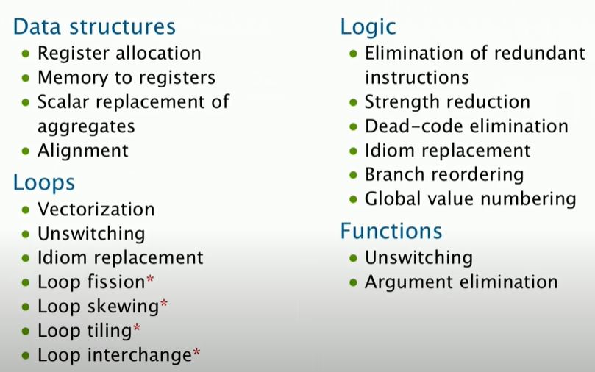
Compiler Optimizations (not exhaustive)

Slide 93
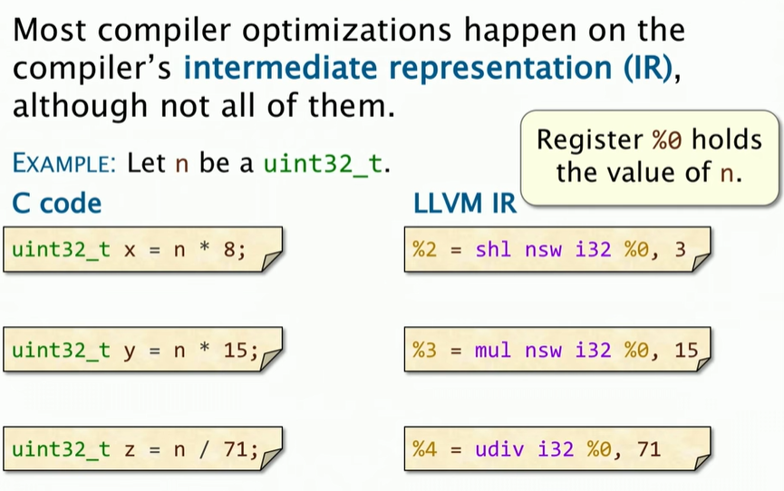
Arithmetic ops: C lang Vs LLVM IR

Slide 94
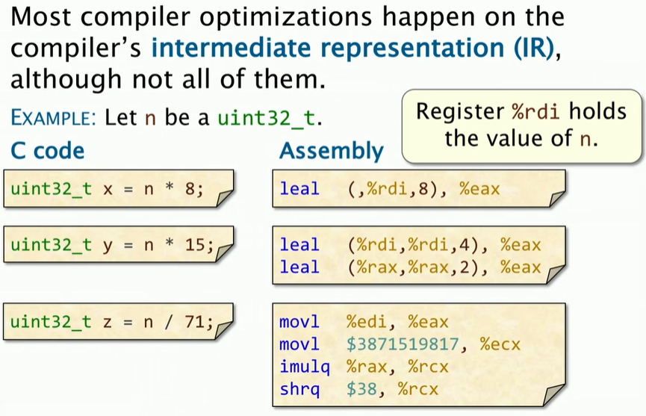
Arithmetic ops: C lang Vs Assembly
Notes:
LEAL instruction in Assembly : Load effective address (i.e. load addr but don’t access memory, i.e. do this calc. and give the result of the calc.)
Do the calc. and store result in the register %eax on the right
LEAL takes the value 8, multiplies it with whatever is in register rdi (which holds the value n) and stores the result in register eax
Address calculator is only capable of doing a small range of operations i.e. multiply by 1,2, 4 or 8
1st LEAL instruction Rdi holds the value n , add to original value of rdi, i.e. 4n+n = 5n store in eax
2nd LEAL instruction
Rax holds 5n now, multiply by 2, i.e. 10n and add rax, i.e. 10n+5n = 15n

Slide 95
Comparison of different Assembly languages
Processor | Instruction
Motorola 6800/68HC11 | LDAA | #$41
Intel x86* | mov | al, 41h
Motorola 680x0 | move.b | #$41, D0
PIC16xx | movlw | 0x41
Motorola 56000 | move | #$0041, A
Intel 80960 | lda | 0x41, r4
*move the hexadecimal value 41h (which is equivalent to the decimal value 65) into the AL register.

Slide 96
Optimization and Performance
How do optimizations improve performance?
Execution_time = num_instructions * CPI
Fewer cycles per instruction
Schedule instructions to avoid dependencies
Improve cache/memory behavior
E.g., locality
Fewer instructions
E.g., target special/new instructions
(Cycles Per Instruction)

Slide 97
Role of Optimizing Compilers
Provide efficient mapping of program to machine
Eliminating minor inefficiencies
Code selection and ordering
Register allocation
Don’t (usually) improve asymptotic efficiency
Up to programmer to select best overall algorithm
Big-O savings are (often) more important than constant factors
But constant factors also matter

Slide 98
Limits of Optimizing Compilers
Operate Under Fundamental Constraints
Must not cause any change in program behavior under any possible condition
Most analysis is performed only within procedures
Inter-procedural analysis is too expensive in most cases
Most analysis is based only on static information
Compiler has difficulty anticipating run-time inputs
When in doubt, the compiler must be conservative

Slide 99
Role of the Programmer
“How to write programs, given a good, optimizing compiler?”
Don’t smash code into oblivion
Hard to read, maintain, and assure correctness
Do
Select best algorithm
Write code that’s readable and maintainable
Procedures, recursion
Even though these factors can slow down code
Eliminate optimization blockers (memory aliasing, side-effects)
Allows compiler to do its job
Focus on Inner Loops
Do detailed optimizations where code will be executed repeatedly
Will get most performance gain here

Slide 100
Compiler Optimizations
Machine independent (apply equally well to most CPUs)
Constant propagation
Constant folding
Common sub-expression elimination
Dead code elimination
Loop invariant code motion
Strength reduction
Function inlining
Machine dependent (apply differently to different CPUs)
Instruction scheduling
Loop unrolling
Parallel unrolling
Could do these manually, better if compiler does them
Many optimizations make code less readable/maintainable

Slide 101
Compiler Optimizations
Constant Propagation (CP)
Replace variables with constants when possible
Constant Folding (CF)
Evaluate expressions containing constants
Can lead to further optimization
E.g., another round of constant propagation
a = 5;
b = 3;
n = a + b;
for (i = 0; i < n ; i++)
{
}
CP
…
n = 5 + 3
n = 5 + 3;
for (i = 0; i < n ; i++)
{
}
…
CF
n = 8
…
…
8

Slide 102
Compiler Optimizations
Common Sub-expression Elimination (CSE)
Try to only compute a given expression once (assuming the variables have not been modified)
Dead Code Elimination (DCE)
Compiler can determine if certain code will never execute
a = c * d;
d = (c * d + t) * u
a = c * d;
d = (a + t) * u
…
⇒
…
debug = 0; // set to False
if (debug)
{
}
a = f(b);
…
debug = 0;
a = f(b);
⇒
…
…

Slide 103
Compiler Optimizations
Loop Invariant Code Motion (LICM)
Loop invariant – value does not change across iterations
LICM will move invariant code out of the loop
for (i = 0; i < 100 ; ++i)
{
t1 = a[i];
for (j = 0; j < 100 ; ++j)
{
tmp = i * j;
t2 = t1[j];
for (k = 0 ; k < 100 ; ++k)
{
t2[k] = tmp * k;
}
}
}
for (i=0; i < 100 ; ++i)
{
for (j=0; j < 100 ; ++j)
{
for (k=0 ; k < 100 ; ++k)
{
a[i][j][k] = i*j*k;
}
}
}
⇒
Results in big performance savings as inner loop will execute 1M times!

Slide 104

Compiler Optimizations
Strength Reduction
Replace expensive operation with simpler ones
Example: multiplication replaced by additions
y = x * 2;
a = b * 4;
y = x + x;
a = b + b + b + b;
⇒
Can be further optimized to: a = b << 2

Slide 105
Compiler Optimizations
Function Inlining
Code size
Can decrease if small procedure body and few calls
Can increase if big procedure body and many calls
Performance
Eliminates call/return overhead
Can expose potential optimizations
Can be hard on instruction-cache if many copies made
int foo(int z)
{
int m = 5;
return z + m;
}
int main()
{
…
{
int foo_z = x;
int m = 5;
int foo_return = foo_z + m;
x = foo_return;
}
…
}
int main()
{
…
x = x + 5;
…
}
⇒
⇒
int main()
{
…
x = foo(x);
…
}

Slide 106
Compiler Optimizations
Loop Unrolling
Reduces loop overhead
E.g., fewer adds to update j
Fewer loop condition tests
Enables more aggressive instruction scheduling
More instructions for scheduler to move around
j = 0;
while (j < 100)
{
a[j] = b[j+1];
j += 1;
}
j = 0;
while (j < 99)
{
a[j] = b[j+1];
a[j+1] = b[j+2];
j += 2;
}
⇒

Slide 107
Optimizing Transformations
int test(int g, int h)
{
int x = 4;
int sum = 0;
do
{
sum += f(g-1,h%4,g+(h%4));
g = x * g + h;
} while (g<128);
return sum;
}
int test(int g, int h)
{
int tmp = h%4;
int sum = 0;
do
{
sum += f(g-1,tmp,g+tmp);
g = g<<2 + h;
} while (g<128);
return sum;
}
constant folding (x = 4)
dead code elimination (declaration of x)
common sub-expression elimination (h%4)
strength reduction (multiply → left shift)
loop invariant removal (h%4 moved outside of loop)

Slide 108
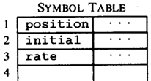




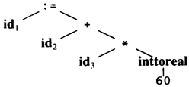
Compiler Example
Code Generator
[Intermediate Code Generator]
Non-optimized Intermediate Code
Scanner [Lexical Analyzer]
Tokens
Code Optimizer
Parser [Syntax Analyzer]
Optimized Intermediate Code
Parse tree
Code Optimizer
Semantic Process [Semantic analyzer]
Target machine code
Abstract Syntax Tree w/ Attributes

Slide 109
Compiler Optimization
CPU speed has increased multiple times since the early 1980s, but today’s software is more complex and still hungry for more resources
How to run faster on same hardware and OS architecture?
Highly optimized applications run ten times faster than poorly written ones
Using efficient algorithms and well-designed implementations leads to high performance applications

Slide 110
Using Optimizing Compilers
What does compiler optimization mean?
Execution time
Code size
Memory usage
Compile time
Understanding and using all the features of an optimizing compiler is required for maximum performance with the least effort

Slide 111
gcc Compiler Optimization Levels
-g
Include debug information, no optimization
-O0
Default, no optimization
-O1
Do optimizations that don’t take too long
CP, CF, CSE, DCE, LICM, inlining small functions
-O2
Take longer optimizing, more aggressive scheduling
-O3
Make space/speed trade-offs: loop unrolling, more inlining
-Os
Optimize program size

Slide 112
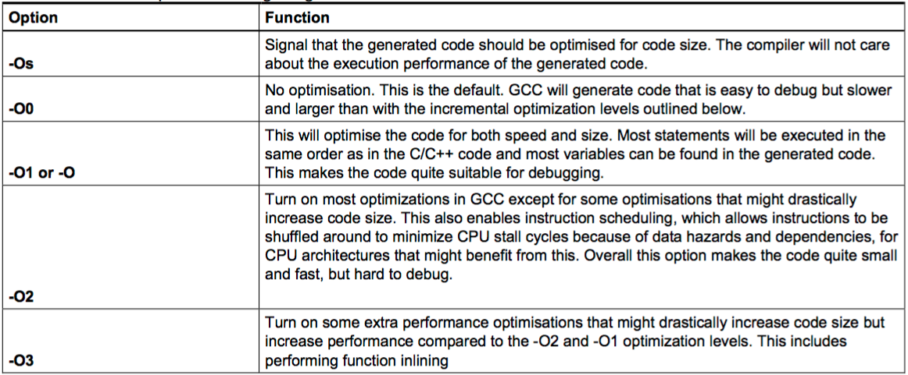
Compiler Optimization
gcc helloworld.c -Q -O3 --help=optimizers > /tmp/03-opts
gcc helloworld.c -Q -O2 --help=optimizers > /tmp/02-opts
diff /tmp/02-opts /tmp/03-opts | grep enabled

